Slide 2
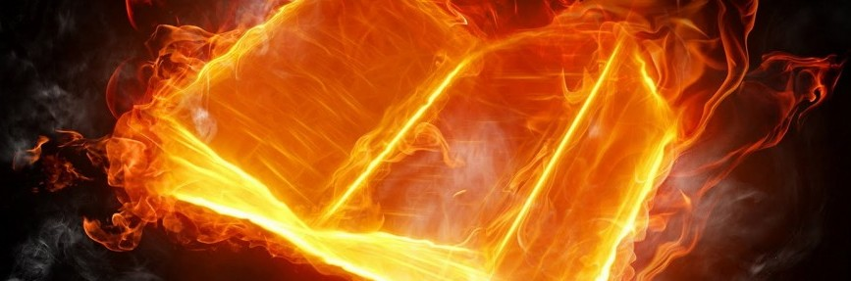
Secure Data Destruction - Burning
Paper documentation

Slide 3
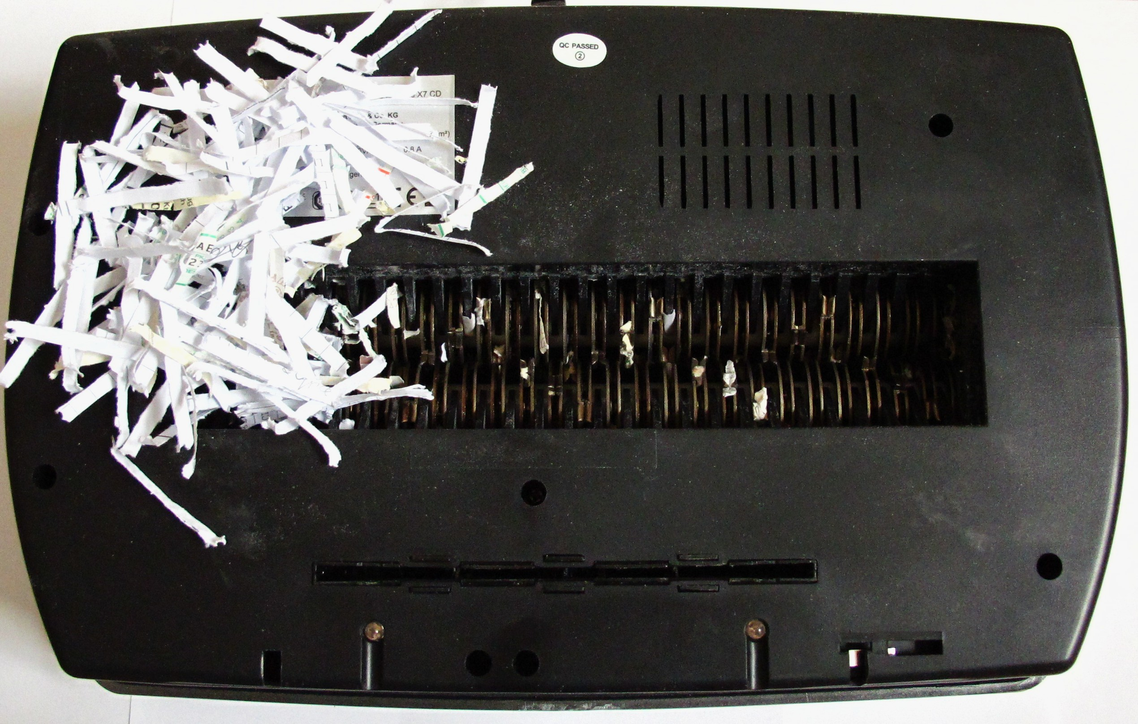
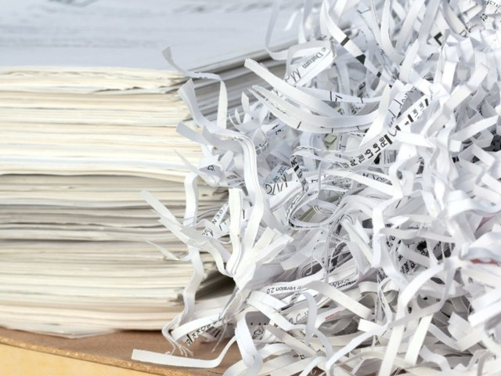
Secure Data Destruction - Shredding
Security Levels
P2 – P6
P4 = Commercial level
P5 = Espionage proof
P6 = DoD/NSA, military
Notes:
Define how small the size of the remanent are

Slide 4
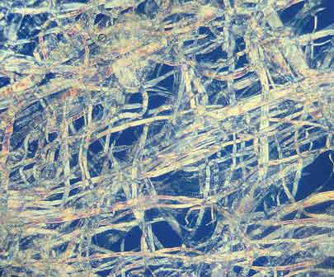
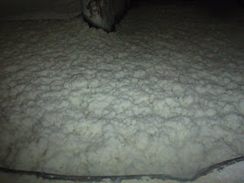
Secure Data Destruction - Pulping
Same process as recycling
Reducing documents to paper slurry

Slide 5

Secure Data Destruction - Overwriting
Writing new data over deleted data
DoD 5220.22 data sanitization standard
Notes:
Pass 1: Overwrite all addressable locations with binary zeroes.
Pass 2: Overwrite all addressable locations with binary ones (the compliment of the above).
Pass 3: Overwrite all addressable locations with a random bit pattern
Verify the final overwrite pass.

Slide 6
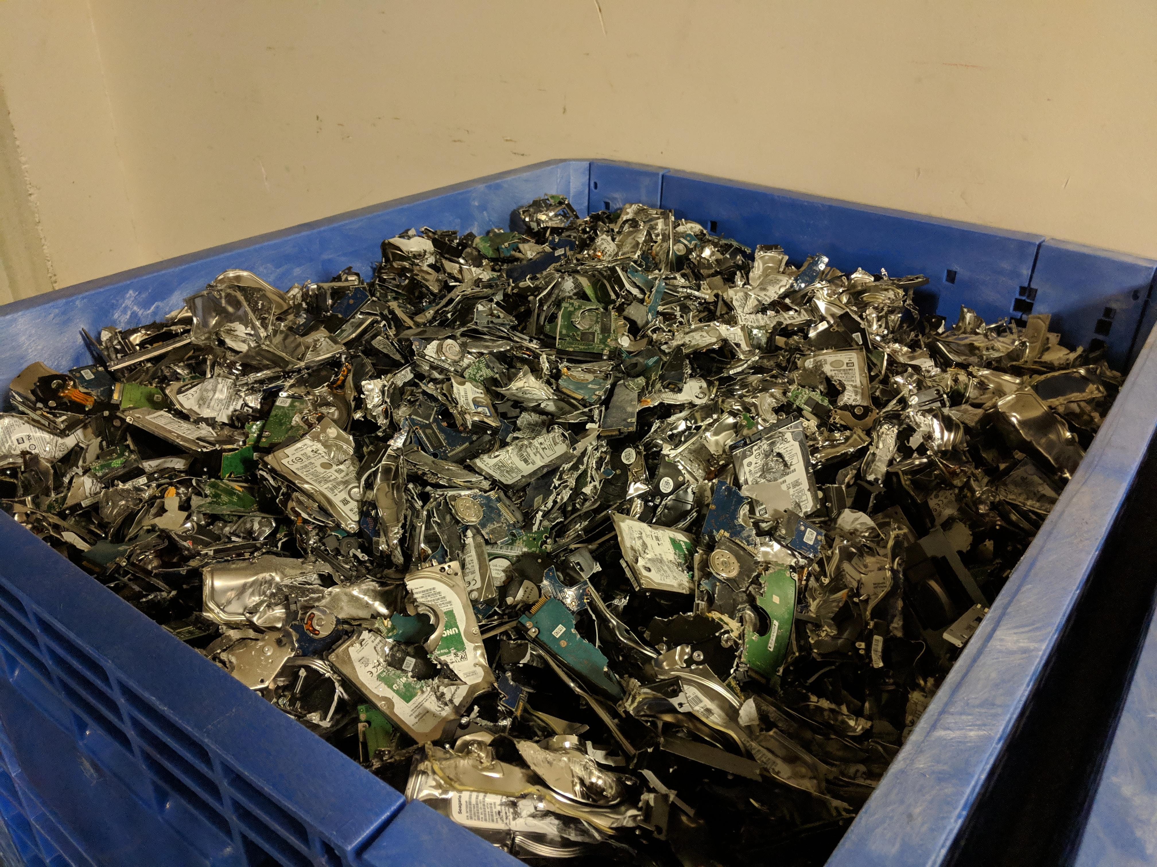
Secure Data Destruction - Pulverizing
Media destruction

Slide 7

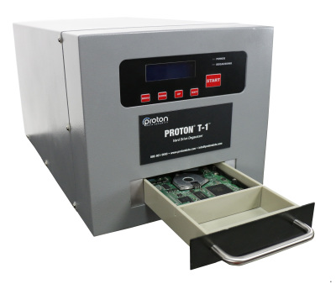
Secure Data Destruction - Degaussing
Strong magnetics
Commercial grade

Slide 8
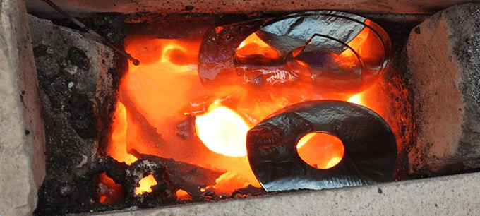
Secure Data Destruction - Incineration
Complete destruction of all media components

